Slide 1

Setting up your optimization problem
Normalizing inputs
deeplearning.ai

Slide 2
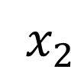
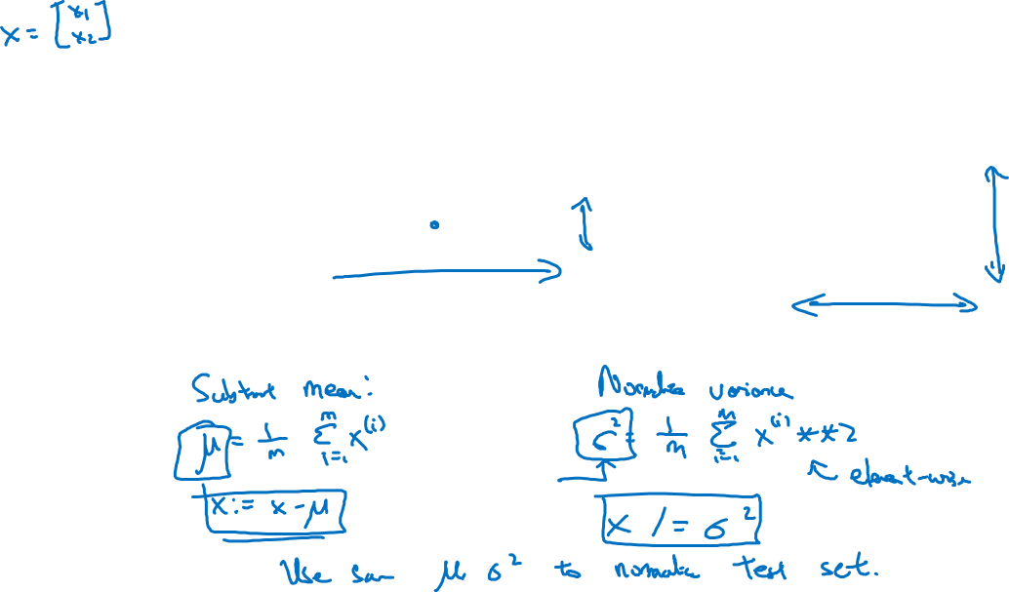
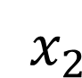
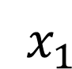
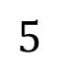
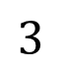
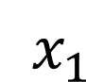
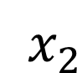
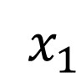
Normalizing training sets
$x_{2}$
$x_{2}$
$$3$$
$x_{2}$
$x_{1}$
$x_{1}$
$x_{1}$
$$5$$

Slide 3
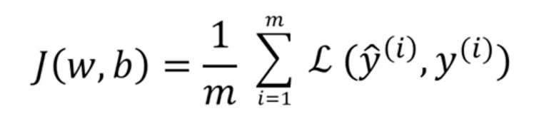
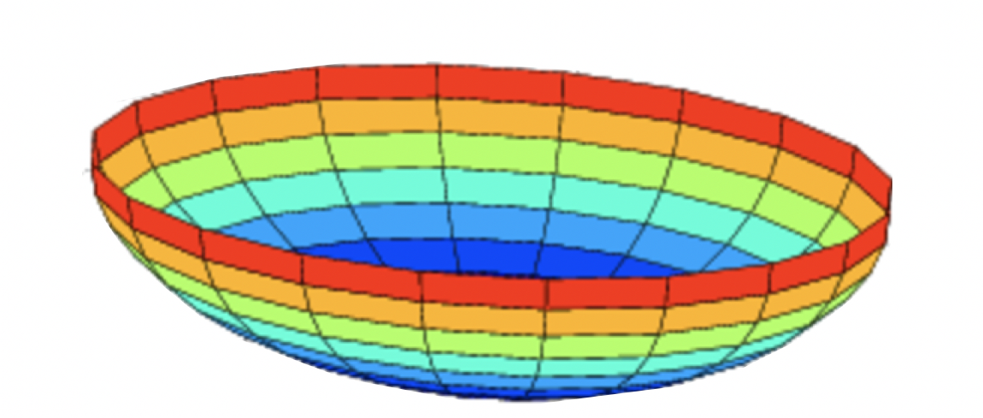
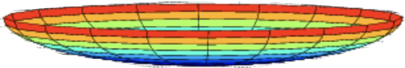
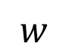
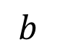
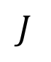
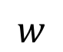
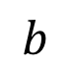
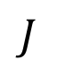
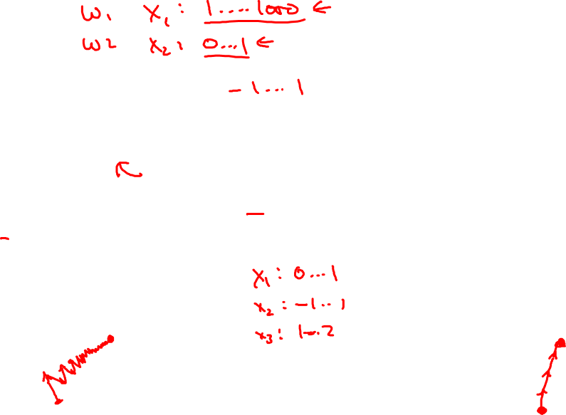
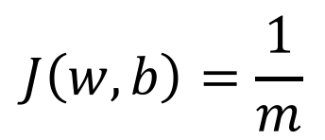
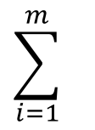
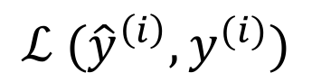
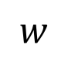
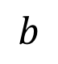
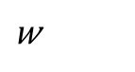
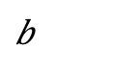
Why normalize inputs?
$$J\left(w,b\right)=\frac{1}{m}$$
$$\sum_{i=1}^{m}{ }$$
$$ℒ ({\hat{y}}^{\left(i\right)},y^{(i)})$$
Unnormalized:
Normalized:
$$J$$
$$J$$
$$w$$
$$w$$
$$b$$
$$b$$
$$b$$
$$b$$
$$w$$
$$w$$

Slide 4
Setting up your optimization problem
Vanishing/exploding
gradients
deeplearning.ai

Slide 5
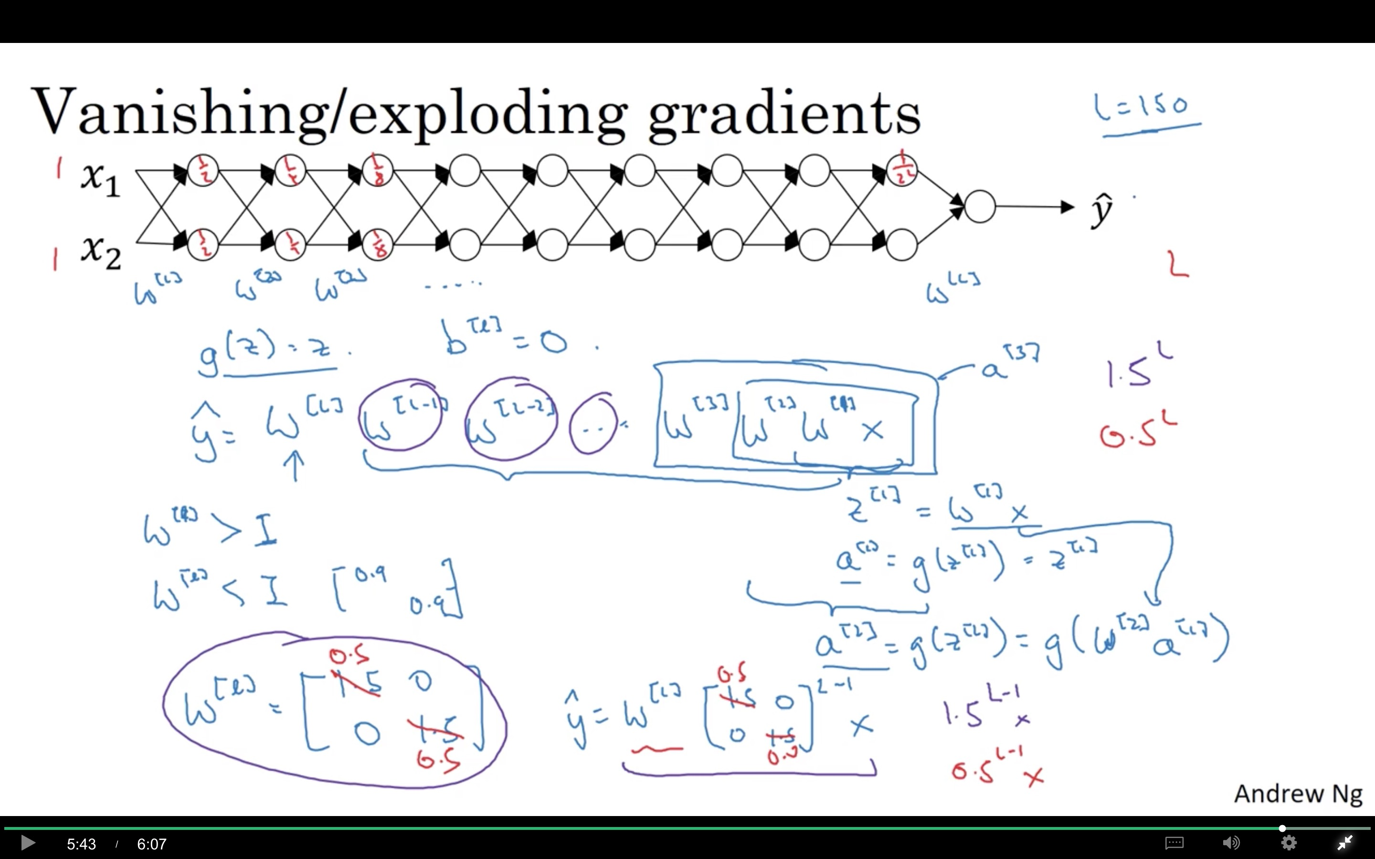

Slide 6
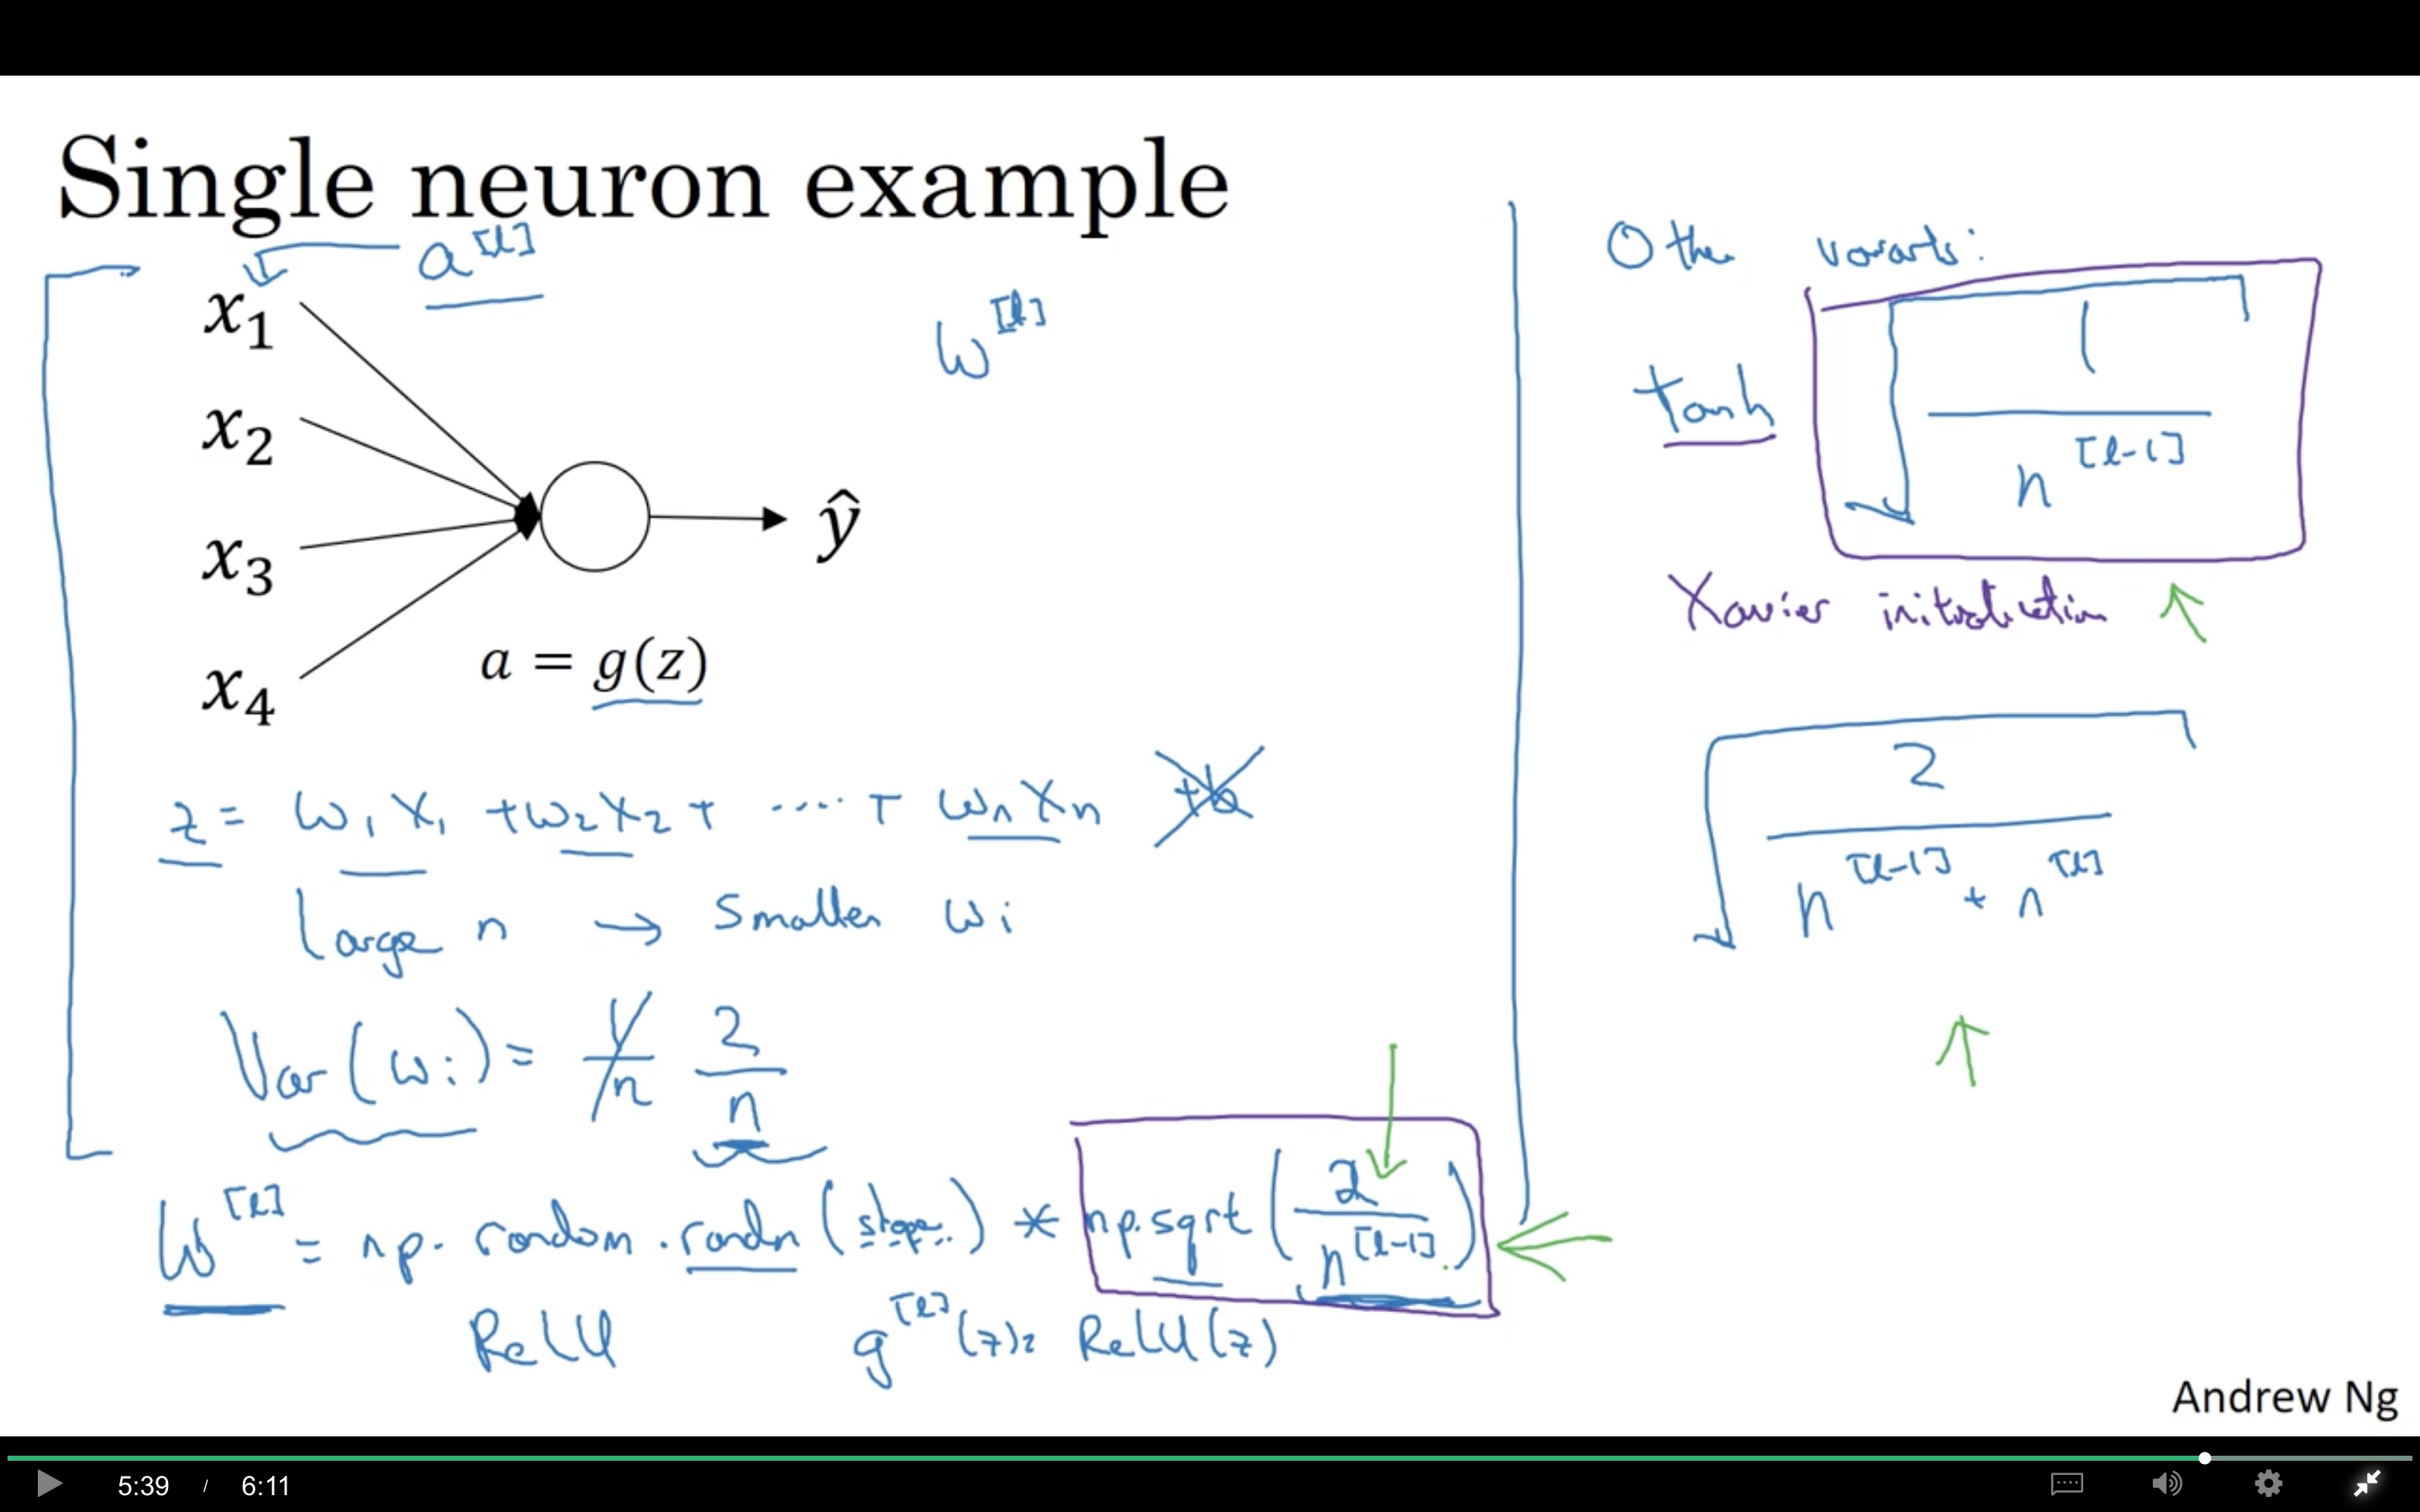

Slide 7
Note: the font is smaller than usual here so it fits nicely.
Setting up your optimization problem
Numerical approximation
of gradients
deeplearning.ai

Slide 8
Checking your derivative computation
$$f$$

Slide 9
Checking your derivative computation
$$f$$
Taylor Theorem

Slide 10
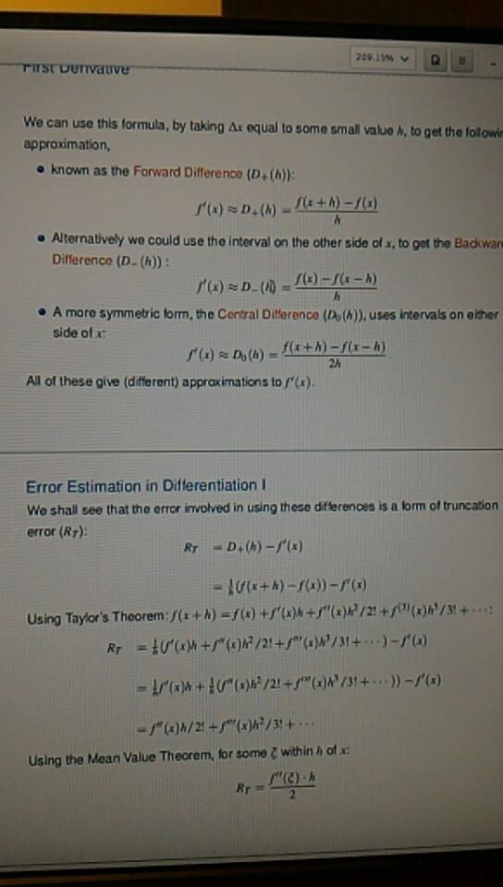

Slide 11
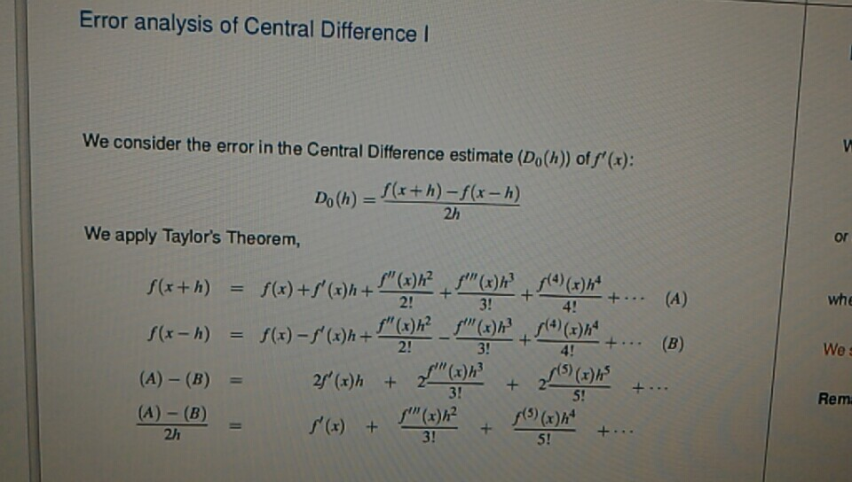

Slide 12
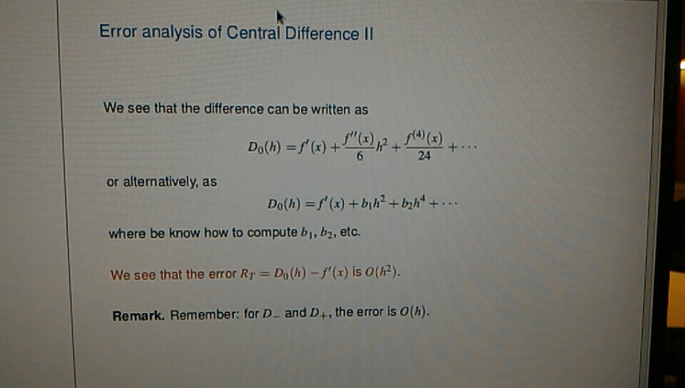

Slide 13
Setting up your optimization problem
Gradient Checking
deeplearning.ai

Slide 14
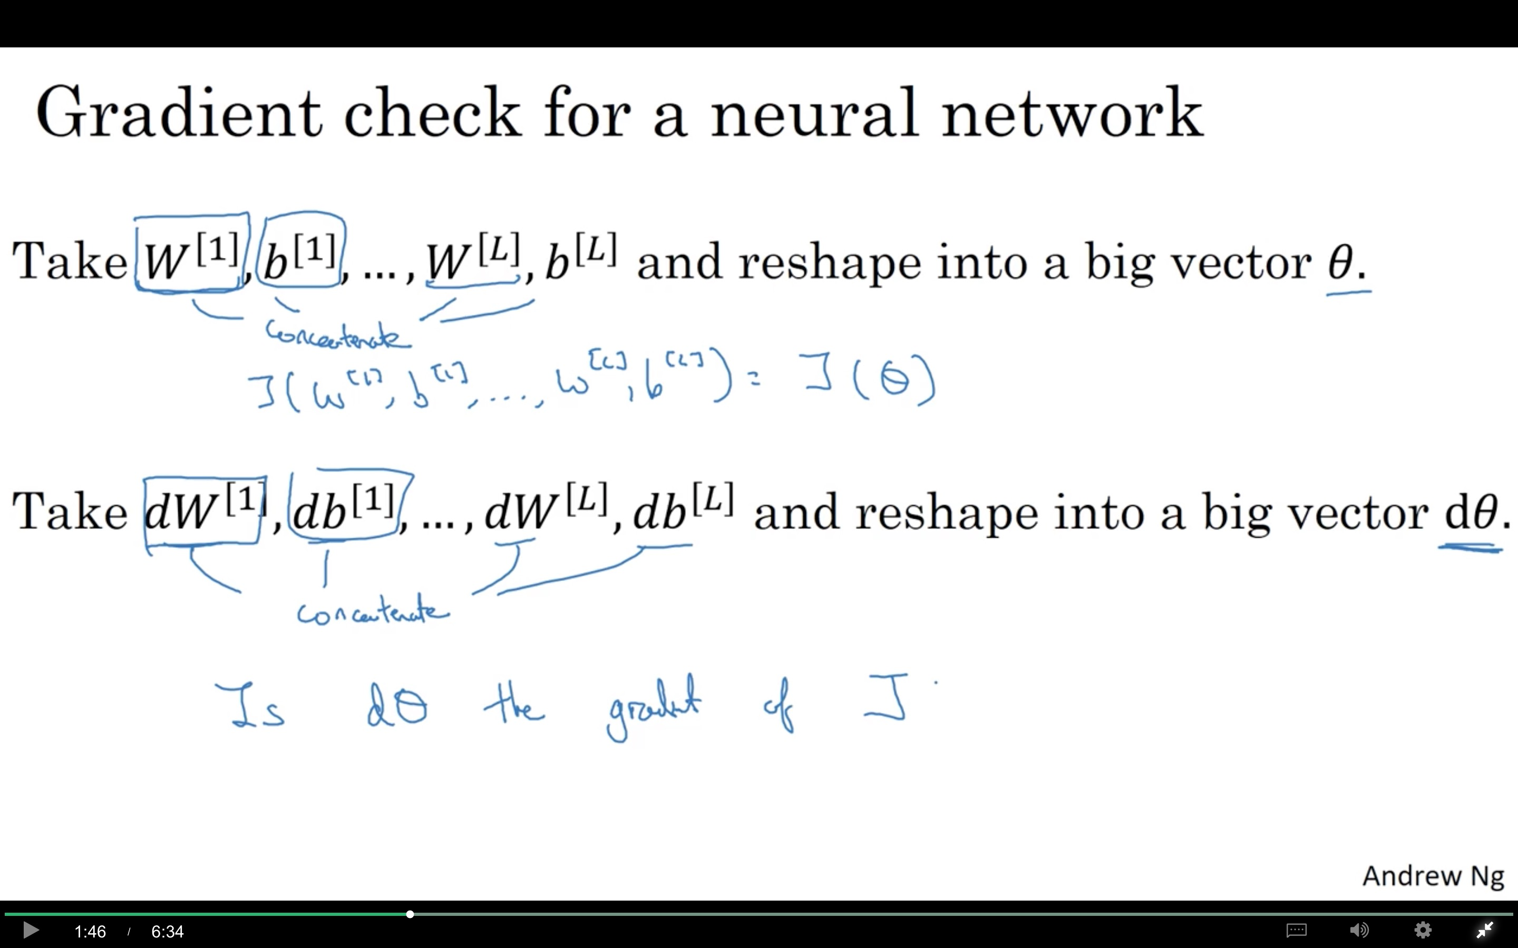

Slide 15
Gradient checking (Grad check)

Slide 16
Setting up your optimization problem
Gradient Checking
implementation notes
deeplearning.ai

Slide 17
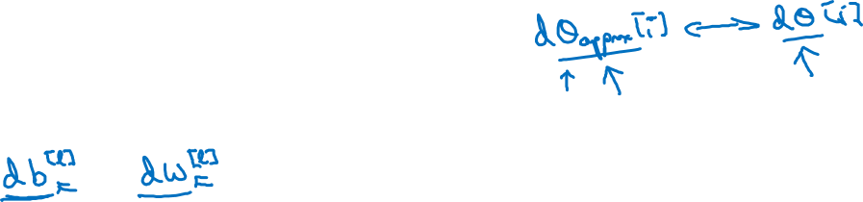
Gradient checking implementation notes
- Don’t use in training – only to debug
- If algorithm fails grad check, look at components to try to identify bug.
- Remember regularization.
- Doesn’t work with dropout.
- Run at random initialization; perhaps again after some training.

